Slide 1
Chapter 9: Social Accounting and Third Sector Organisations
Contemporary Issues in Social Accounting

Slide 2
Chapter Structure
Introduction
The nature and purpose of Third Sector Organizations (TSOs)
The importance of TSOs in the modern economy
Reporting practices and governing challenges in TSOs
Governing Practices in TSOs
Accountability in TSOs
Summary
Additional reading materials

Slide 3

The nature and purpose of
Third Sector Organizations
The mission of the Gavi - Vaccine Alliance
is to “sav(e) children’s lives and protect people’s
health by improving the availability of vaccines
in lower-income countries”.
  Civil society organizations play a key role in advancing Gavi’s vision and mission.

Slide 4

The nature and purpose of
Third Sector Organizations
The United Nations (UN) defines the “civil society” as the “third” sector (TS) in terms of economic activity, placing it alongside the first and second sectors.
Third sector
  Do not aim for profit and profit distribution,
  They are self-governed,
  Social impact is the main measure of success,
  Based on donations and voluntary work.

Slide 5
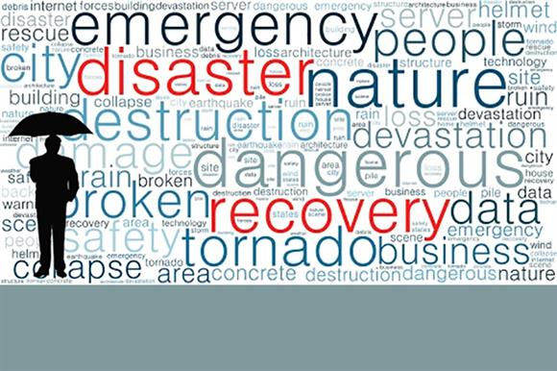
The nature and purpose of
Third Sector Organizations
TSOs consist of:
  Community groups,
  Voluntary organizations,
  Charities,
  Social enterprises,
  Co-operatives
  Business forums,
  Faith based associations,
  Labour unions,
  Philanthropic
  Foundations,
  Think tanks.

Slide 6
The importance of TSOs in the modern economy
Over the past 30 years, the importance and influence
of civil society in economic and social activity has increased.
Reasons:
  TSOs are instrumental in promoting democratic governance and efficient public administration in developing countries.
  TSOs are key drivers in the efficient design and implementation of development and financial aid programmes.

Slide 7
The importance of TSOs in the modern economy
Reasons (cont.)
  The European welfare social model is challenged.
    Public Sector’s ability is criticized over its ability to deliver financially sustainable social services.
    Capacity for innovation and engagement with local communities, as well as the ability to serve citizens facing more complex problems, seem to create the point of differentiation for TSOs in delivering social services in partnership with public sector organizations

Slide 8

The importance of TSOs in the modern economy
The impact of TSOs on private sector:
  TSOs improve labor skills and quality of workforce,
  TSOs create job opportunities,
  TSOs promote trust, innovation and entrepreneurship,
  TSOs induce a new ethos in commercial activities and influence consumers’ preferences.

Slide 9
Reporting practices and governing challenges in Third Sector Organizations
In the UK charities are expected to produce annual reports and accounts that transparently demonstrate the sources and
uses of funds.
The UK Accounting Standards Board (ASB) regulates
financial reporting practices for charities, and
it supports the application of reporting standards by
issuing Statements of Recommended Practices (SORPs).

Slide 10
Reporting practices and governing challenges in Third Sector Organizations
Financial accounts are prepared on the basis of accrual accounting.
Audited financial statements
  Statements of financial activities,
  Balance sheet,
  Cash flow statement,
  Notes to the accounts,
  Annual report.

Slide 11
Reporting practices and governing challenges in Third Sector Organizations
Reporting challenges
  Small charities.
    Tend not to meet the minimum reporting standards.
  Large charities.
    Financial reports meet regulatory standards.
    Financial reports are regularly examined or audited by independent bodies.
    However, they fail to make apparent and disclose evidence on how the activities performed made a difference to their beneficiaries.

Slide 12
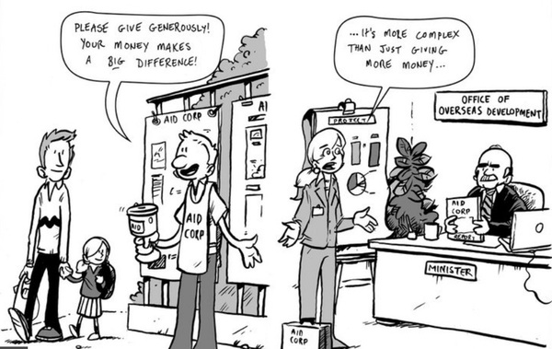
Reporting practices and governing challenges in Third Sector Organizations
Management challenges
  Poor management,
  Absence of professionalism,
  Few efficiency measurements,
  Lack of effective accounting practices that would enhance both accountability and transparency.

Slide 13
Reporting practices and governing challenges in Third Sector Organizations
Overhead Myth
  Non-profits and charities are mission and value driven organizations;
  their existence and funding are based on relationships built upon trust and in association with donors who will respond negatively when organizational resources are spent on salaries and administrative expenses.
  Donors tend to criticize overhead spending and reward charities with minimal overhead costs.

Slide 14

Reporting practices and governing challenges in Third Sector Organizations
Overhead Myth (cont.)
  The percentage of charities’ overhead expenses to fundraising activities, is considered by donors as a key indicator of how effective a nonprofit organization uses the cash raised from donations.
  Poor accountability and control are attributed to higher overhead costs.

Slide 15
Reporting practices and governing challenges in Third Sector Organizations
Overhead Myth (cont.)
  The validity of using solely financial measurements in evaluating the performance of TSOs in delivering their objectives have been challenged.
  Underinvestment in infrastructure may result in lower operating standards, serving fewer beneficiaries by sustaining a smaller network and collecting fewer grants by not being able to identify potential donors.

Slide 16
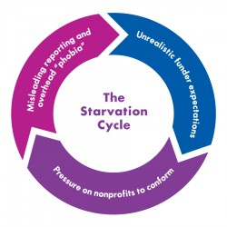
Reporting practices and governing challenges in Third Sector Organizations
Nonprofit Starvation Cycle
  The term used to describe a vicious cycle of persistent underfunding of overhead costs, with the outcome of donors’ unrealistic expectations of civil organizations to deliver more with less.
  This predictable cycle ignores the fact that some overhead expenses are necessary and good for the organization and should, in fact, be seen as an investment in effective program delivery.

Slide 17
Governing Practices in
Third Sector Organizations
The pressure exercised by funding institutions, including government agencies, donors and foundations on the TSOs to conform to the expectations for lower overhead expenses indicates conflicts of interest between principals and agents.
This principal-agent relationship may concern the interaction between trustees and managers or the interaction between donors and trustees.
Agents have been assigned the responsibility of managing transparency and the effective management of funds that civil organizations raise.

Slide 18
Governing Practices in
Third Sector Organizations
From an agency theory perspective, the prioritization of financial metrics in measuring performance indicates the effort of principals-donors to keep agent-managers/trustees accountable for meeting the mission and scope of the charity.
Financial metrics employed for making the use of donations transparent and enhancing the trust of donors on the way charities raise and use funds.

Slide 19
Governing Practices in
Third Sector Organizations
Evidence exists that in the non-profit sector, the board of trustees exercises weak control over the behaviour of managers.
Moreover, they find it difficult to oversee all services provided by the organization.

Slide 20
Governing Practices in
Third Sector Organizations
Governance
  Good governance is founded on a clear mission, organizational structure and decision-making processes.
  When activities performed are in alignment with the values and processes of the organization, outcomes are consistent with its mission and reporting complies with the required reporting standards.

Slide 21
Governing Practices in
Third Sector Organizations
Governing Principles:
  an effective board will provide good governance and leadership by members understanding their role,
  ensuring delivery of organizational purpose,
  working effectively both as individual and a team,
  exercising effective control,
  behaving with integrity,
  being open and accountable.

Slide 22
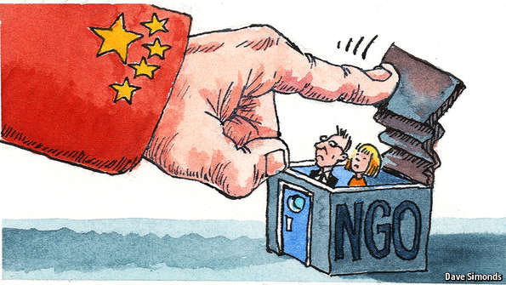
How these lenses impact Accountability in the TS
Black-hole of Accountability:
  misappropriation of resources to corruption,
  high administrative costs,
  high executive compensations,
  wealth accumulation,
  commercialization,
  inability to effectively achieve their mission .

Slide 23

How these lenses impact Accountability in the TS
Roles of Accountability:
  legitimacy
  overall performance
  credibility to their donors and beneficiaries
  independence

Slide 24

How these lenses impact Accountability in the TS
Types of Accountability:
  Upward
  Downward
  Horizontal

Slide 25
How these lenses impact Accountability in the TS
Upward, Hierarchical or Functional Accountability:
  Donors, foundations, partnering TSOs or government agencies often require them to provide formal accounting of how the resources at their disposal were used
  Outline the immediate impact of their services.
  enables funders to assert significant financial, governance and/or policy control by demanding accountability for the services provided.
  Assess the efficiency of the funds donated based on pre-determined performance metrics

Slide 26
How these lenses impact Accountability in the TS
Why does Upward Accountability matter?
  tax exemption status
  access to governmental and humanitarian aids
  prevent fraud
  Ensure that they are not profit oriented.

Slide 27
How these lenses impact Accountability in the TS
Tools for Upward Accountability?
  Annual reports, interim reports performance assessment reports and performance evaluation reports
Criticisms of Upward Accountability?
  accountability mechanism has proven counter-productive by damaging the delivery of their services to those they are intended to benefit

Slide 28
How these lenses impact Accountability in the TS
Downward Accountability:
  the need for TSOs to share the financial and social impacts of the services they provide with their beneficiaries and the communities they serve
  used to assess the needs of TSO beneficiaries and to understand whether those needs have been addressed with the services rendered

Slide 29
How these lenses impact Accountability in the TS
Why does Downward Accountability matter?
  humanitarian aids delivered did not reflect the humanitarian needs of the survivors
  beneficiaries have no feedback/accountability mechanism to access the suitability of the services they received

Slide 30
How these lenses impact Accountability in the TS
Tools for Downward Accountability?
  participatory dialogues, participatory evaluations and social audits to monitor performance and to establish accounting information systems
  participatory rural appraisal visits and participatory learning and action initiatives that could include surveys, public meetings, or a formal dialogue on projects

Slide 31
How these lenses impact Accountability in the TS
Criticisms of Downward Accountability?
  Consultative approach to downward accountability does not necessarily imply inclusive and effective engagements with beneficiaries
  Inadequate in incorporating beneficiaries’ needs and views prior to the design and the implementation projects.
  Validate the views of their funders, rather than reflect the opinions and views of their beneficiaries

Slide 32
How these lenses impact Accountability in the TS
Holistic Accountability:
  addresses the accountability relationships of TSOs with its broader and to its mission statement
  encompasses a broader form of accountability than upward or downward accountability
  include qualitative and quantitative measures of the short and long-term impacts of the TSOs actions to multifaceted stakeholders

Slide 33
How these lenses impact Accountability in the TS
Why does Holistic Accountability matter?
  Upward and downward accountability as a subset of holistic accountability
  Emphasis on the moral responsiveness to the needs of their beneficiaries
  Emphasis on the moral inclusiveness of their beneficiaries in decision making
  TSOs’ responsibilities to its donors and government.
  TSOs’ responsibilities to its partners.
  TSOs’ responsibilities to its mission statement

Slide 34
How these lenses impact Accountability in the TS
Tools for Holistic Accountability?
  participatory evaluation, stakeholders’ forum and surveys,
  partnership with beneficiaries to develop and implement their programs
  storytelling which enable beneficiaries to describe their experiences and perceptions of the activities of the organization.
  striving to address its overall functional accountability to its donors and government

Slide 35
Summary
  purpose of improving the lives of others and solving social problems.
  provide social services in countries where the public sector is deemed inefficient
  Accountability to financial contributors, volunteers and beneficiaries is high on their agenda
  Accountability, is important for legitimizing purposes.

Slide 36
Summary (Cont.)
  Tax exemption status
  Upward forms of accountability
  Downward accountability
  Holistic accountability
36

Slide 37


Slide 38
Additional reading materials
Agyemang, G., Awumbila, M., Unerman, J. and O’Dwyer, B. (2009). NGO Accountability and aid delivery. London: Certified Accountants Educational Trust.
Association of Chief Executives of Voluntary Organizations (2010) Good Governance: A code for the voluntary and community sector [online], 2nd ed., revised, available: http://greyhoundrescuewales.co.uk/wp-content/uploads/2015/09/Code-of-Governance-Full1-copy-2.pdf
Bedsworth, W. Goggins, A. G. and Howard, D. (2008). Nonprofit Overhead Costs: Breaking the Vicious Cycle of Misleading Reporting, Unrealistic Expectations, and Pressure to Conform, The Bridgespan Group (April), available: www.bridgespan.org

Slide 39
Additional reading materials (cont.)
Boomsma, R. and O’Dwyer, B. (2014). The nature of NGO accountability, conceptions, motives, forms and mechanisms. In: J. Bebbington, J. Unerman and B. O’Dwyer (2nd ed.), Sustainability, Accounting and Accountability, pp.157-175. Oxon: Routledge.
Burger, R. and Seabe, D. (2014). NGO Accountability in Africa. In: E. Obadare (ed.). The handbook of civil society in Africa, pp.77-94, New York: Springer.
Charities and Trustee Investment (Scotland) Act 2005, The Charities Accounts (Scotland) Regulations [online], Scottish Statutory Instruments, No. 218, (May 17, 2006), available: www.legislation.gov.uk/ssi/2006/218/pdfs/ssi_20060218_en.pdf

